Slide 1
Docker, .NET Core, and Entity Framework
Nate McMaster
Software Engineer, ASP.NET
@natemcmaster

Slide 2
Talk source code
github.com/natemcmaster/docker-ef-talk

Slide 3
Agenda
The stack, from the bottom up
Docker
.NET Core
Entity Framework
Putting it all together
Q/A

Slide 4
https://www.docker.com/what-docker

Slide 5
What is Docker?
Docker containers wrap up a piece of software in a complete filesystem that contains everything it needs to run:
code,
runtime,
system tools,
system libraries
anything you can install on a server.
This guarantees that it will always run the same, regardless of the environment it is running in.
https://www.docker.com/what-docker

Slide 6
What is Docker?
It works on my box but not in production
I need to call my IT admin to install ___ on all servers
localEnvironment.Equals(productionEnvironment)

Slide 7
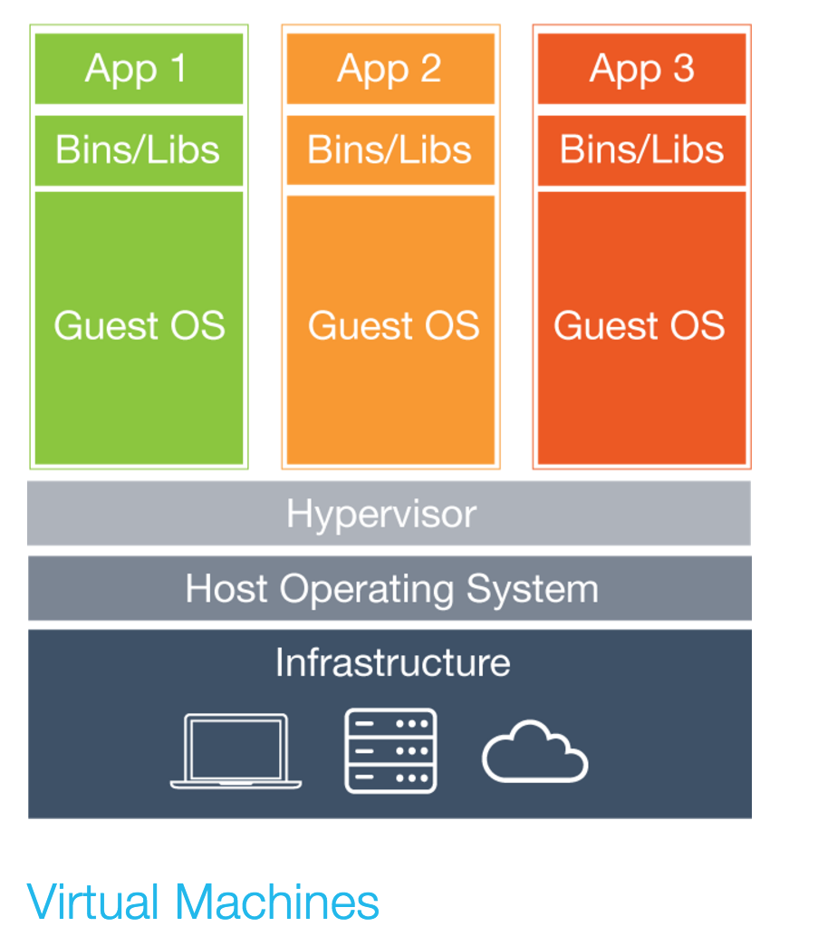
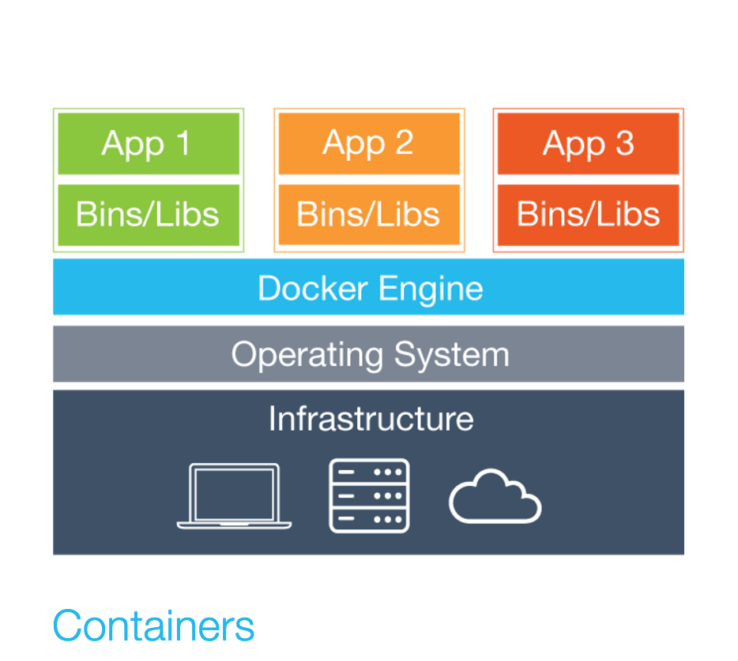
How is this different from a virtual machine?
https://www.docker.com/what-docker

Slide 8
What applications are available on Docker?
Dozens of popular, open-source database, web, and app servers
https://hub.docker.com/explore
https://www.microsoft.com/en-us/server-cloud/sql-server-on-linux.aspx

Slide 9
Docker demos
Notes:
- create and run Jenkins image
- show images vs containers
- what are volumes?
- networking

Slide 10
1 – Docker 101
Docker Toolbox
Docker machine
docker pull
docker run

Slide 11
2 – Docker demo
Volumes

Slide 12
2 – Docker demo
Creating a docker image
Other examples:
https://github.com/jenkinsci/docker/blob/5a51d0a519cb6605280adb8719f0e050ea69bac6/Dockerfile

Slide 13
.NET Core

Slide 14
.NET
Compiler (C#)
Base class libraries
Execution engine (runtime)

Slide 15
Entity Framework Core

Slide 16
Feedback/questions?
nate.mcmaster@microsoft.com
https://github.com/natemcmaster/docker-ef
Notes:
https://qtrial2016q2az1.az1.qualtrics.com/jfe/form/SV_1IbdrVmjxxBPrjn

Slide 17
Presentation title goes here
Speaker name
Title

Slide 18
Preferred text layout (no bullets)
Main topic 1: size 40pt
Size 20pt for the subtopics
Size 20pt for the subtopics
Main topic 2: size 40pt
Size 20pt for the subtopics
Size 20pt for the subtopics
Main topic 3: size 40pt
Size 20pt for the subtopics
Size 20pt for the subtopics

Slide 19
Bullet points layout with subtitle Subtitle
Example of a bulleted slide with a subhead
Set the slide title to “Sentence case”
Set subheads to “Sentence case”
Hyperlink style
www.microsoft.com

Slide 20
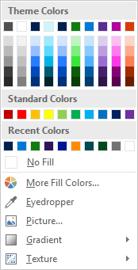
Slide palette info
The PowerPoint palette for this template has been built for you and is shown below. Avoid using too many colors in your presentation.
Accent colors 1-6 – (6 Theme Colors to the far right)
Accent 1
Accent 2
Accent 3
Accent 4
Accent 5
Accent 6
Use Accent 1 as the main accent color. Use Accent 2 and Accent 3 when additional colors are needed.
Use Accents 4-6 sparingly – only when more colors are necessary.

Slide 21
Section title

Slide 22
Photo layout 1

Slide 23
Software code slide
This slide layout uses Consolas, a monotype font which is ideal for showing software code.

Slide 24
Notes (hidden)
Some speakers at Microsoft like to use this slide for hidden “notes slides”.
Delete it if you don’t want to use it.
NEXT: <next slide title>

Slide 26
Microsoft brand template
White
Dark Blue
PowerPoint template for the Microsoft brand – January 2016
Questions: brand@microsoft.com

Slide 27
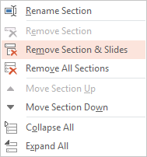
This template has 3 sections
View slides in sorter mode to see all 3 sections
1st section: Instructions, (this section)
2nd section: Slide layouts using the WHITE TEMPLATE master
3rd section: Slide layouts using the COLOR TEMPLATE master
Delete any slides or sections you don’t need
To remove a slide, select it and then hit Delete
To remove an entire section, change the view to Slide Sorter mode: View menu > Slide Sorter. Then right-click on the section name, and choose “Remove section and slides”

Slide 28
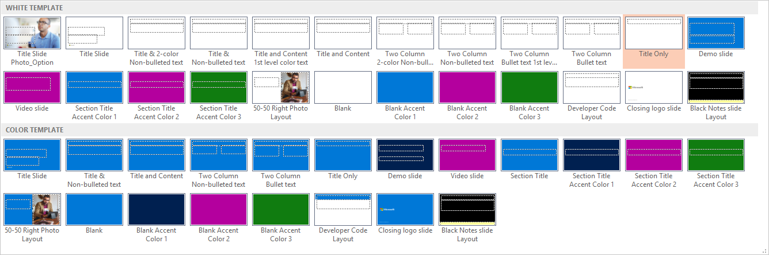
Working with slide layouts
To add a new slide, click the Insert menu along the top. On the far left, click on the words New Slide (not the slide icon), which will reveal the Slide Layout menu. (See below – colors and photos may vary from your template.)
Select a layout from the dropdown menu. Scroll down to see all the layouts. Notice that there are 2 masters: WHITE TEMPLATE and a second COLOR TEMPLATE. While both masters provide some slides with color backgrounds, the WHITE TEMPLATE provides a variety of text layouts with white backgrounds, and the COLOR TEMPLATE provides a variety of text layouts with color backgrounds. Refer to the text descriptions below each layout for additional information about each.
For questions: email slides

Slide 29
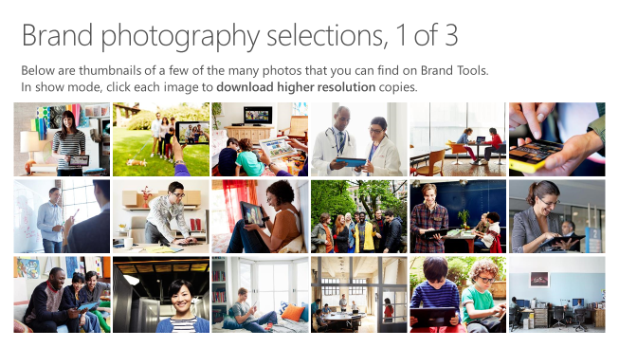
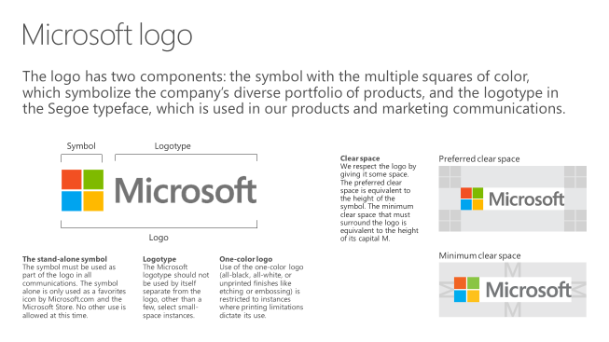
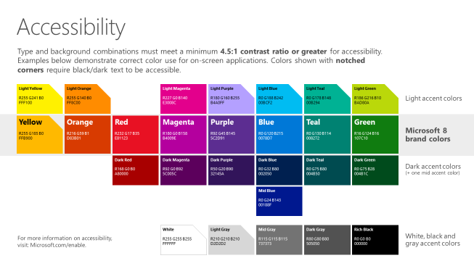
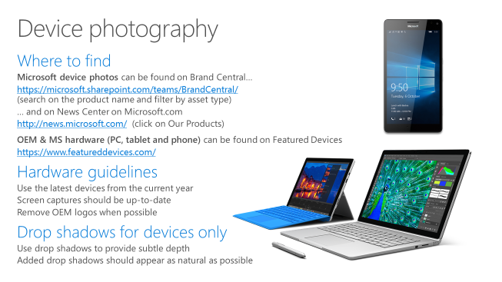
Microsoft brand guidelines
Looking for more slide resources?
Brand guidelines for PowerPoint templates is a separate slide deck that provides an overview of the Microsoft brand, guidelines, resources, tips and much more.
A few of the slides are shown at right.
Download from: https://microsoft.sharepoint.com/teams/BrandCentral/Pages/Presentations.aspx

Slide 30
Presentation title goes here
Speaker name
Title

Slide 31
Preferred text layout (no bullets)
Main topic 1: size 40pt
Size 20pt for the subtopics
Size 20pt for the subtopics
Main topic 2: size 40pt
Size 20pt for the subtopics
Size 20pt for the subtopics
Main topic 3: size 40pt
Size 20pt for the subtopics
Size 20pt for the subtopics

Slide 32
Bullet points layout with subtitle Subtitle
Example of a bulleted slide with a subhead
Set the slide title to “Sentence case”
Set subheads to “Sentence case”
Hyperlink style
www.microsoft.com

Slide 33
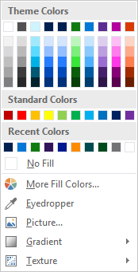
Slide palette info
The PowerPoint palette for this template has been built for you and is shown below. Avoid using too many colors in your presentation.
Select the 4th color from the left for subheads and 1st level non-bulleted text color, or wherever “color” text is preferred over the default black/white text
Accent colors 1-6 – (6 Theme Colors to the far right)
Text
Dark 2
Accent 1
Accent 2
Accent 3
Accent 4
Accent 5
Accent 6
Use Accent 1 as the main accent color. Use Accent 2 and Accent 3 when additional colors are needed.
Use Accents 4-6 sparingly – only when more colors are necessary.

Slide 34
Section title

Slide 35
Photo layout 1

Slide 36
Software code slide
This slide layout uses Consolas, a monotype font which is ideal for showing software code.

Slide 37
Notes (hidden)
Some speakers at Microsoft like to use this slide for hidden “notes slides”.
Delete it if you don’t want to use it.
NEXT: <next slide title>

